Slide 1
Home Security System
Group Leader – Parth Manekar (11071)
Aditya Game (11063)
Prathamesh Malu (11065)
Yash Sancheti (11072)
Raghav Zanwar (11070)

Slide 2
Introduction
A simple definition of an EMS is a system to control and monitor energy consuming devices, which may include heating and cooling equipment, fans, pumps, dampers, and lighting. Energy management systems can also be used to control refrigeration equipment, industrial processes, or other systems.

Slide 3


1. Intro
This project is divided into some parts:
Abstract
System Design
Hardware Required
Descriptions
Coding
Software and Hardware Testing
Conclusion

Slide 4

Abstract
•The project is designed for optimum energy management based on counter, light intensity and temperature sensor. The system also counts the number of persons entering and leaving the room and displays that information on LCD display. Depending on person’s entry as well as exiting condition the room appliances will play their role. The ultimate objective of this system is to save the energy as well as to design automatic room light controller by turning off all the appliances when nobody is there in the home.
•In this project we are using arduino UNO, LDR sensor, DHT-11 sensor, IR sensors, LCD display, fan and lamp. There are two pair sensors, each kept at certain distance from the other. One pair of sensor consists of a transmitter and a receiver, kept exactly opposite to each other. The transmitting part emits modulated IR light which is received at the receiver end and fed to a microcontroller of arduino UNO family.

Slide 5
System Design!
In this project we are using arduino uno, ldr sensor, dht-11 sensor, ir sensors, lcd display, fan and lamp. There are two pair sensors, each kept at certain distance from the other. One pair of sensor consists of a transmitter and a receiver, kept exactly opposite to each other.

Slide 6
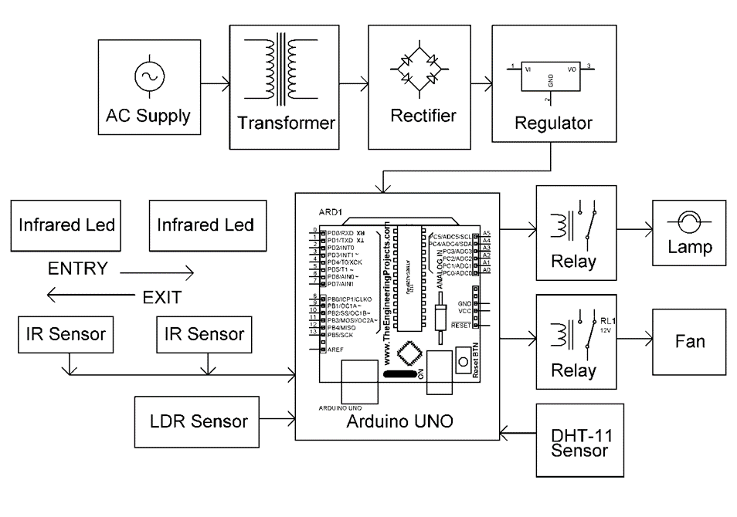
Block Diagram
This is an block diagram for our system.

Slide 7
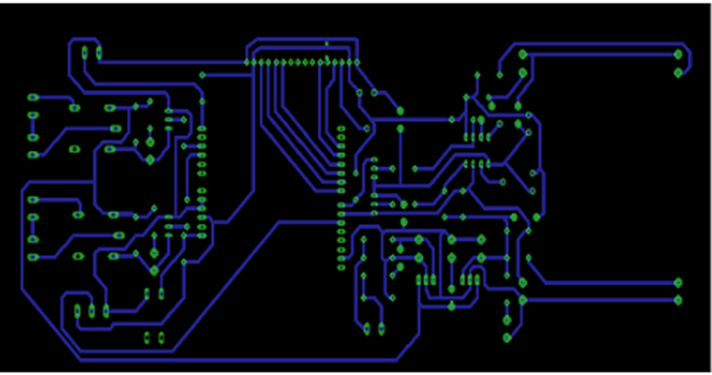
PCB Layout
PCB means Printed Circuit Board on which we have soldered our connections.

Slide 8
Hardware Required with Description
Here’s a list of the hardware parts required for the project:
Transformer
Arduino
LCD Display
DHT-11 Sensor
Infrared LED
IR Sensor
LDR Sensor
Resistor
Fuse
Bulb Holder
Cables and Connectors
LED
Resistors
Capacitors
·
Diode
Lamp
Fan
Relay
Transistors

Slide 9
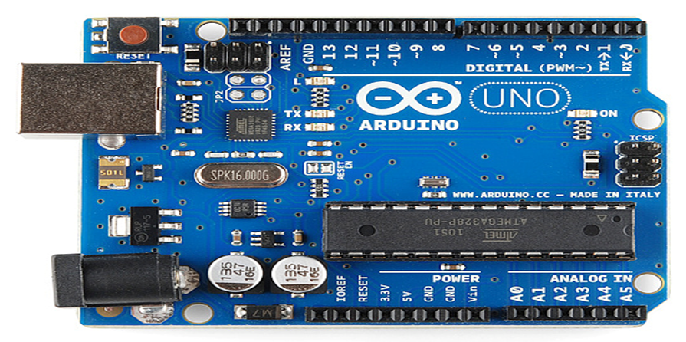
Arduino
Powering of UNO
Arduino Uno can be powered by using a single usb cable only and can be connected (i.e. physically and code) with any computer using the same.
Arduino is an open-source platform used for building electronics projects. Arduino consists of both a physical programmable circuit board (often referred to as a microcontroller) and a piece of software, or IDE (Integrated Development Environment) that runs on your computer, used to write and upload computer code to the physical board.

Slide 10
The recommended voltage for most Arduino models is between 6 and 12 Volts, never give voltage more than 20V.
The pins on your Arduino are the places where you connect wires to construct a circuit .
An Arduino Uno consists of :
3 Ground (GND)
4 5V and 5 3.3V
6 AnalogIn (which reads signals like temperature sensors)
7 Digital (can be used as both input and output pin)
8 PWM (Pulse - Width Modulation , acts as normal pins for connecting wires to breadboard and uno)
9 AREF (Analog Reference pins)
Reset Button
Power LED

Slide 11
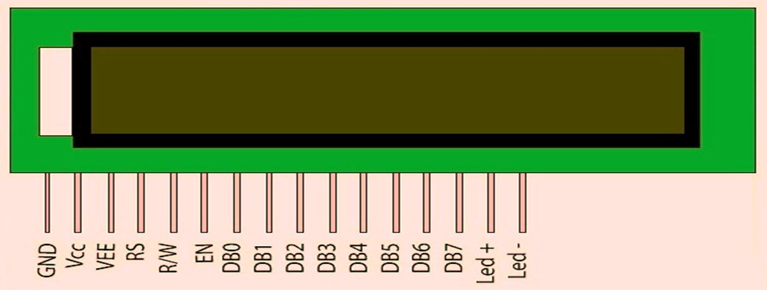
2. LCD Display
LCD (Liquid Crystal Display) screen is an electronic display module and find a wide range of applications. A 16x2 LCD display is very basic module and is very commonly used in various devices and circuits.
A 16x2 LCD means it can display 16 characters per line and there are 2 such lines. In this LCD each character is displayed in 5x7 pixel matrix. This LCD has two registers, namely, Command and Data.
A command is an instruction given to LCD to do a predefined task like initializing it, clearing its screen, setting the cursor position, controlling display etc. The data register stores the data to be displayed on the LCD. The data is the ASCII value of the character to be displayed on the LCD.

Slide 12
All LCDs have :
8 Data pins → Carries 8-bit data/command from an external unit like microcontroller.
VCC
VEE
GND
RS (Register Select)
RW (Register Write)
EN (Enable Signal)
V0 → Sets contrast of lcd by rotating potentiometer knob forward or backward.
Led + → Anode of back light and always connected to Vcc
Led - → Cathode of back light and always connected to GND

Slide 13
VEE → VEE pin is meant for adjusting the contrast of the LCD display and the contrast can be adjusted by varying the voltage at this pin. This is done by connecting one end of a POT to the Vcc (5V), other end to the Ground and connecting the center terminal (wiper) of the POT to the VEE pin.
Register Select (RS) → There are 2 types of registers in every led :
Command Register(CR) : RS = 0 means CR is selected.
Data Register(DR) : RS = 1 means DR is selected.
Read Write (RW) → When RW=1 We want to read data from lcd. When RW=0 We want to write to lcd.
Enable Signal → When you select the register(Command and Data) and set RW(read - write) now its time to execute the instruction.

Slide 14
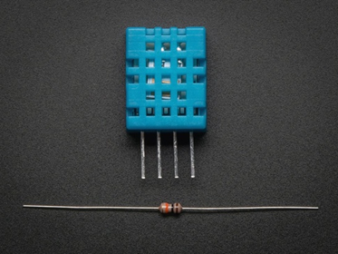
3. DHT11 humidity sensor
It uses a capacitive humidity sensor and a thermistor to measure the surrounding air, and spits out a digital signal on the data pin. Its fairly simple to use, but requires careful timing to grab data. The only real downside of this sensor is you can only get new data from it once every 2 seconds, so when using our library, sensor readings can be up to 2 seconds old.
Technical details:
· Low cost
· 3 to 5V power and I/O
· 2.5mA max current use during conversion (while requesting data)
· Good for 20-80% humidity readings with 5% accuracy
· Good for 0-50°C temperature readings ±2°C accuracy
· No more than 1 Hz sampling rate (once every second)
· Body size 15.5mm x 12mm x 5.5mm
· 4 pins with 0.1" spacing
DHT 11

Slide 15
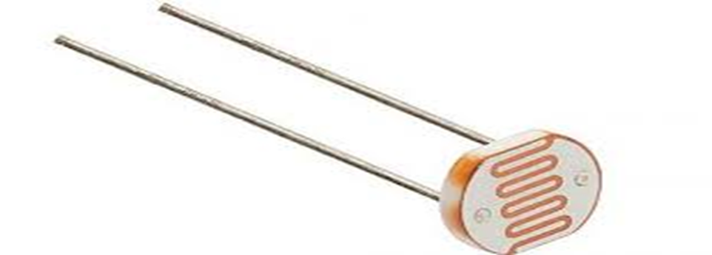
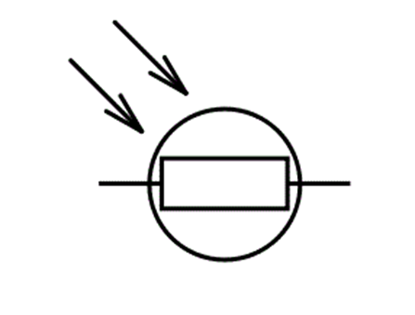
4. LDR
A Light Dependent Resistor (LDR) or a photoresistor is a device whose resistivity is a function of the incident electromagnetic radiation. Hence, they are light sensitive devices. They are also called as photo conductors, photo conductive cells or simply photocells.
They are made up of semiconductor materials having high resistance. There are many different symbols used to indicate a LDR, one of the most commonly used symbol is shown in the figure below. The arrow indicates light falling on it.
LDR

Slide 16
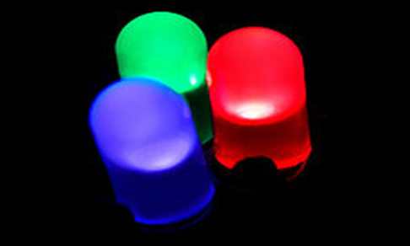
5. LED
LEDs are semiconductor devices. Like transistors, and other diodes, LEDs are made out of silicon. What makes an LED give off light are the small amounts of chemical impurities that are added to the silicon, such as gallium, arsenide, indium, and nitride. When current passes through the LED, it emits photons as a byproduct. Normal light bulbs produce light by heating a metal filament until its white hot. Because LEDs produce photons directly and not via heat, they are far more efficient than incandescent bulbs.

Slide 17
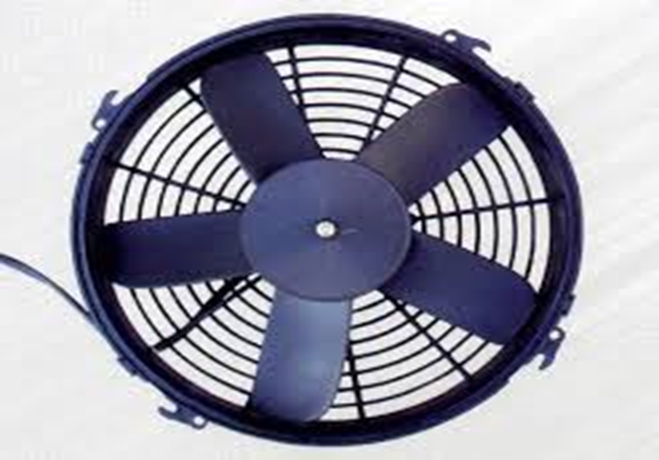
6. DC FAN MOTOR
This motor could be characterized as the modern kind of DC motor. The letters BLDC means Brush-Less Direct Current. So, these motors have no brushes.

Slide 18
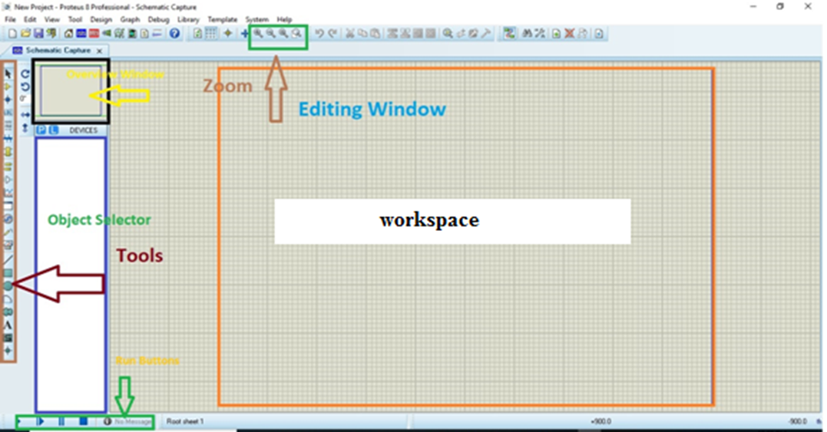
DESIGN
The PCB Layout module is automatically given connectivity information in the from the schematic capture module. It applies this information, together with the user specified design rules and various design automation tools, to assist with error free board design. PCB's of up to 16 copper layers can be produced with design size limited by product configuration

Slide 19
Testing
Continuity Test
a continuity test is the checking of an electric circuit to see if current flows
Power on test
performed to check whether the voltage at different terminals is according to the requirement or not.

Slide 20
Continuity Test
A continuity test is performed by placing a small voltage across the chosen path. If electron flow is inhibited by broken conductors, damaged components, or excessive resistance, the circuit is "open".
An important application is the continuity test of a bundle of wires so as to find the two ends belonging to a particular one of these wires; there will be a negligible resistance between the "right" ends, and only between the "right" ends.
This test is the performed just after the hardware soldering and configuration has been completed. This test aims at finding any electrical open paths in the circuit after the soldering. Many a times, the electrical continuity in the circuit is lost due to improper soldering, wrong and rough handling of the PCB, improper usage of the soldering iron, component failures and presence of bugs in the circuit diagram. We use a multi meter to perform this test. We keep the multi meter in buzzer mode and connect the ground terminal of the multi meter to the ground. We connect both the terminals across the path that needs to be checked. If there is continuation then you will hear the beep sound.

Slide 21
Power Testing
We take a multi meter and put it in voltage mode. Remember that this test is performed without microcontroller. Firstly, we check the output of the transformer, whether we get the required 12 v AC voltage.
Then we apply this voltage to the power supply circuit. Note that we do this test without microcontroller because if there is any excessive voltage, this may lead to damaging the controller. We check for the input to the voltage regulator i.e., are we getting an input of 12v and an output of 5v. This 5v output is given to the microcontrollers’ 40th pin. Hence we check for the voltage level at 40th pin. Similarly, we check for the other terminals for the required voltage. In this way we can assure that the voltage at all the terminals is as per the requirement

Slide 22
Software Testing
We checked assembly language program then we found that the loop given in the program is incorrect so we check it and then it place it at proper place so it program work in correct manner .also there is small problem regarding with port so we change number of port and then our program is able to use in our project.

Slide 23
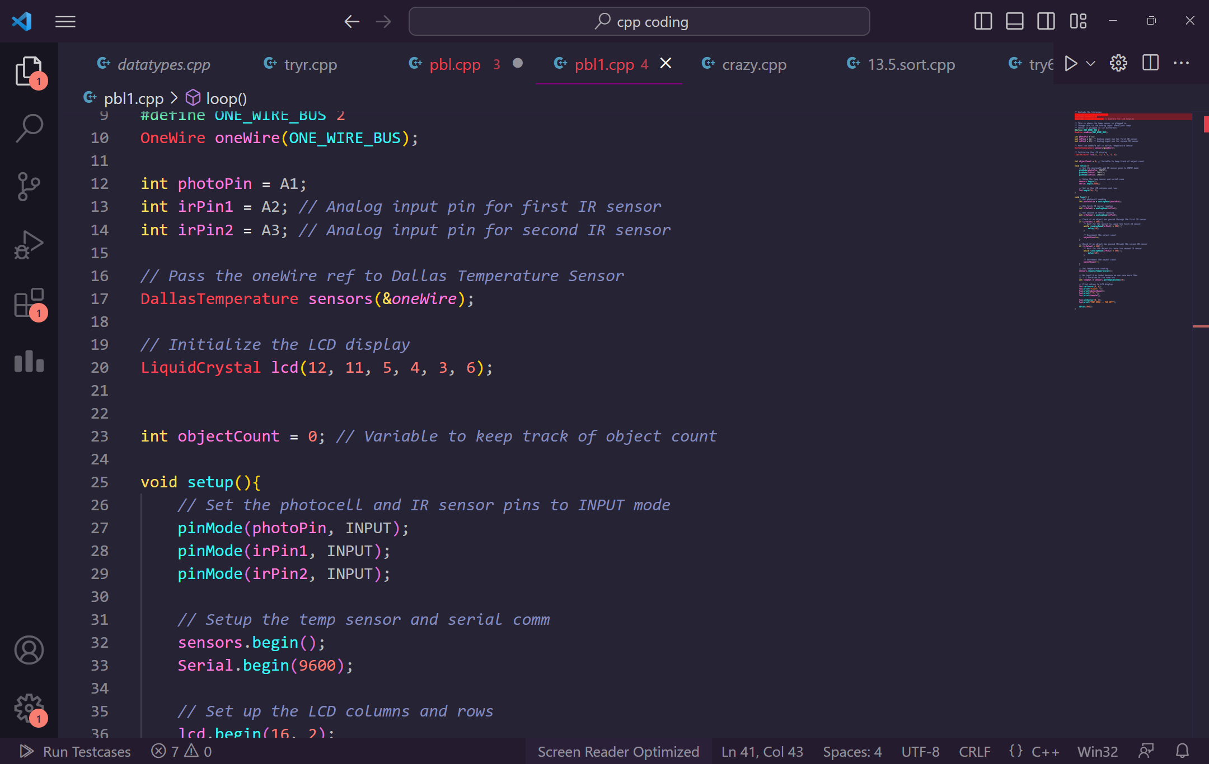

Slide 24
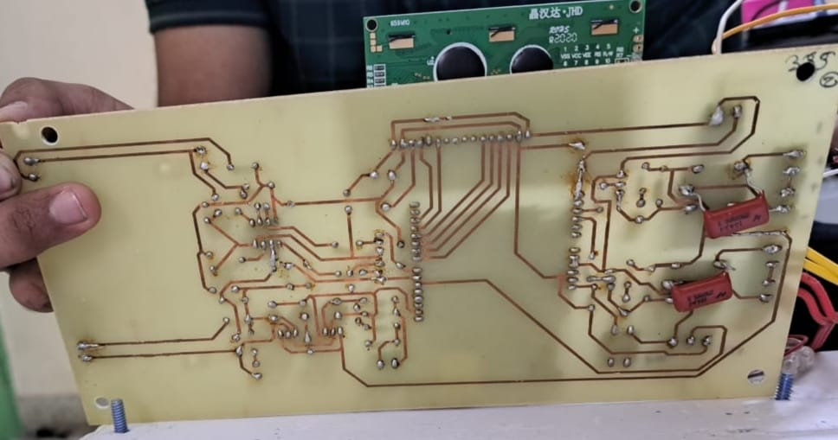
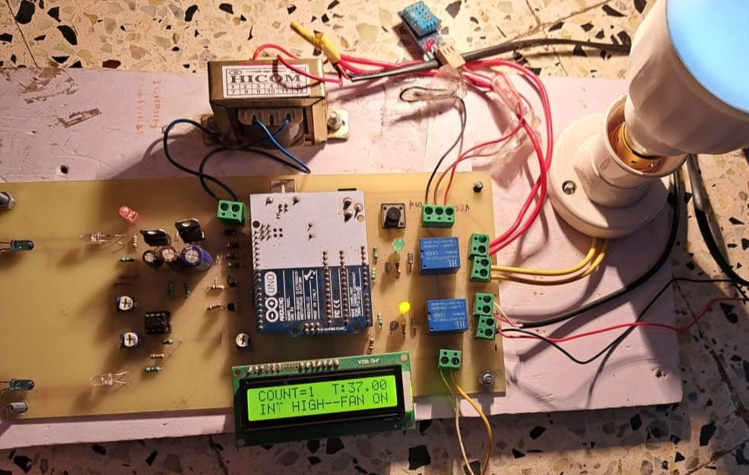
This is how our project looks like.

Slide 25
Conclusion
Build confidence around your product or idea by including at least one of the these slides:
Conclusion
Application
Advantage

Slide 26
Conclusion
The project can be implemented for a double security check for home when the homeowner has gone out where he will be informed through a call that a burglary has happened at his residence and he should immediately attend to that.
It also caters to the need of energy management, which checks the presence of people inside and switches on the lights and fan based upon the weather condition. All this will give a person the freedom to work on more important issues.

Slide 27
Application
For many buildings, the EMS has more power than any other equipment to make or break the operation of the facility.
For this reason, the owner, facility manager, and system operator should work together on the management aspects as well as the technical aspects of EMS to optimize cost and energy savings as well as tenant comfort.

Slide 28
Advantages
1. An EMS is a system that monitors, controls and optimizes energy usage and transmission.
2. The most obvious of all benefits is the EMS's ability to reduce electricity costs by monitoring and optimizing energy used for lighting, heating and cooling, ventilation,
3. Managing and reducing energy consumption not only saves money but also helps in mitigating climate change and enhancing corporate reputation. Energy management is widely acknowledged as the best solution for direct and immediate reduction of energy consumption.

Slide 29
Thank You!!!

